Slide 1
X-Car review n°3
Team Chidi
December 19 / 2023
Authors :
Ana Carolina Coelho Robl
Arthur Nicola
Baptiste Turpin
Loïc Thomas
Nicolas Siard
Pierre Bonnecaze
Louis Vialan
Well-John Lu

Slide 2





Introduction - why the X-Car ?
Transport heavy loads around the campus
An intelligent car that you can trust
An intuitive interface for the user

Slide 3
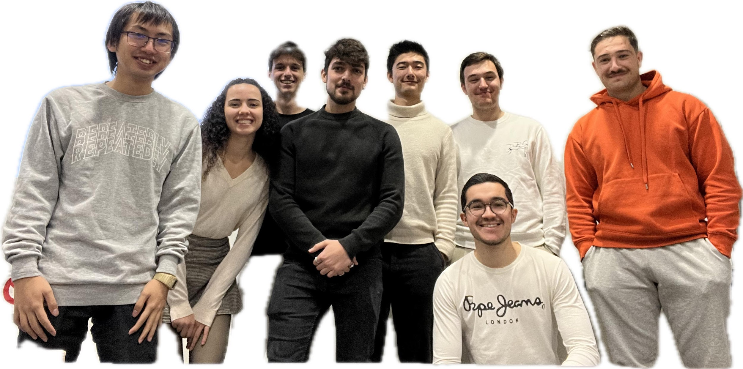

The team

Slide 4











Realised Stories
Story 1 : Improve Web Interface
Story 2 : Improve Tracking mode
Story 3 : A safer and more accurate
Tracking mode

Slide 5




Story 1 : Web interface
Implementation in the web interface : Battery - State machine - Joystick - History
+
+
=
+
+

Slide 6


Next Sprint : story 1
System checking : As a user, I want to check that the system is functioning correctly and that all sensors are operational: Baptiste Well-John Ana
Task 1- Detect when a sensor has stopped to work correctly
13 Story Points
Task 2- Display the information on the web interface
5 Story Points
Task 3- Add obstacle detection in front of the car (tracking mode)
8 Story Points

Slide 7


Story 2 : Tracking a person
Objectives
Check if the car can follow the user in a 15 degree turn
Check if the Xcar can recognise only the user in a window vision with several humans
Check if X-Car avoid an obstacle that appears behind the user in a straight line

Slide 8


Story 2 : Tracking a person
Following a person on a small curve
Follow the user in a straight line at a fixed distance (1.5m)
Control the car steering according to the user position in front of the car
Coupled linear displacement and wheel steering to track the user
Control the wheels speed independently to improve the car's steering

Slide 9
Story 2 : Tracking a person
Following a person on a small curve
Follow the user in a straight line at a fixed distance (1.5m)
Control the car steering according to the user position in front of the car
Coupled linear displacement and wheel steering to track the user
Control the wheels speed independently to improve the car's steering

Slide 10



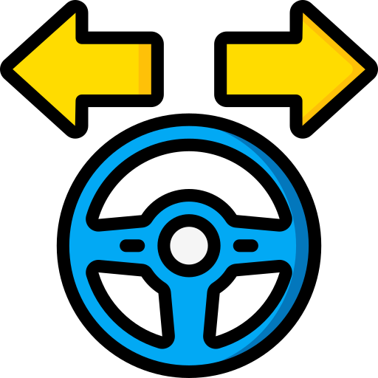
Story 2 : Tracking a person
Control the car steering according to the user position in front of the car
How does it work ?
The camera returns an image
Analyses image to identify user
Calculate the angle between the car and the person
Apply angle to wheel steering

Slide 11
Story 2 : Tracking a person
Control the car steering according to the user position in front of the car
I'm going to stand in front of the car
Move to the left and check that the wheels are turning in my direction
Repeat on the right side
The control loop is not super-precise and the position oscillates slightly in some cases

Slide 12



Story 2 : Tracking a person
Identifying the different persons detected by the camera
Check that the camera can detect all the people present in the camera’s view
For each person, assign a unique ID
Each person keep their ID along all the tracking
The ID of the target stays unchanged if he is briefly hide by something or left the camera’s view

Slide 13
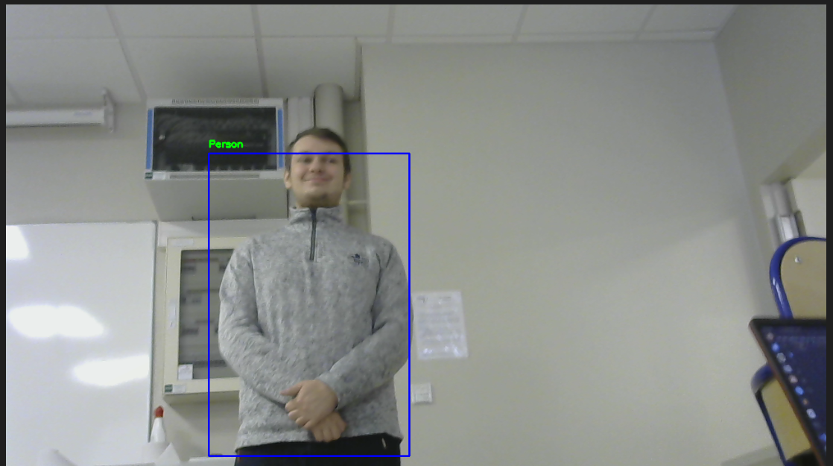
Story 2 : Tracking a person
More accuracy in Human detection and ID attribution

Slide 14
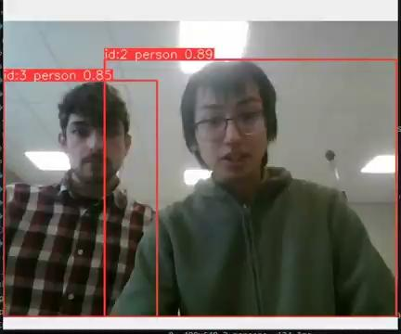
Story 2 : Tracking a person
More accuracy in Human detection and ID attribution

Slide 15
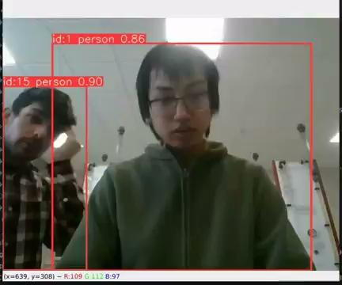
Story 2 : Tracking a person
More accuracy in Human detection and ID attribution

Slide 16

Story 2 : Tracking a person
Detect obstacles while the car is tracking a person ( backward )
Obstacle must be detected at 70 cm
70 cm
1.50m

Slide 17
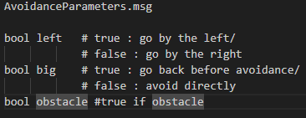
Story 3 : A safer and more accurate Tracking mode
Objectives
Add obstacle avoidance in our tracking mode
Give the direction to take for the car.
Improve the accuracy of our measurements
It works with the combination of Lidar detection and Ultrasonic detection.

Slide 18
Story 3 : A safer and more accurate Tracking mode
Test
Turn on the left
No Obstacle
Obstacle On the right
And turn
Go back
Big Obstacle

Slide 19
Next Sprint : story 2
Tracking : As a user, I want to be followed in a small curve and I want the X-car to be able to avoid obstacles : Nicolas - Arthur - Louis - Loïc - Pierre
Task 1- Avoid obstacle and controlling the trajectory
13 Story Points

Slide 20
Next Sprint : story 2
Tracking : As a user, I want to be followed in a small curve and I want the X-car to be able to avoid obstacles : Nicolas - Arthur - Louis - Loïc - Pierre
Task 2- Combine the person tracking feature with the orientation of the wheel according to the position of the person in order to follow the user on a small curve
19 Story Points

Slide 21
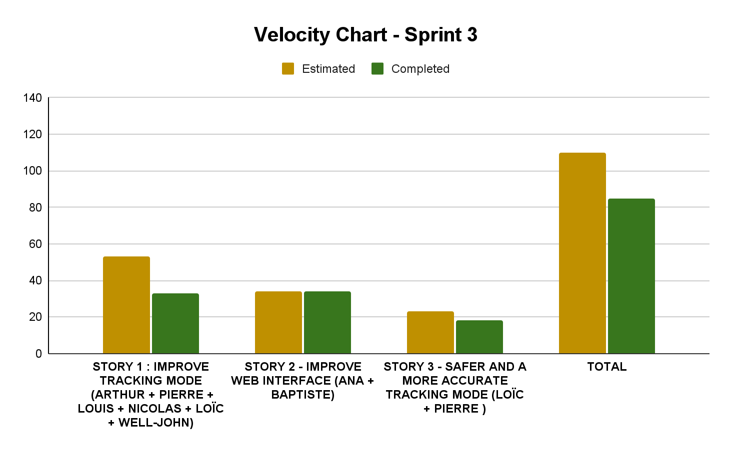

Slide 22
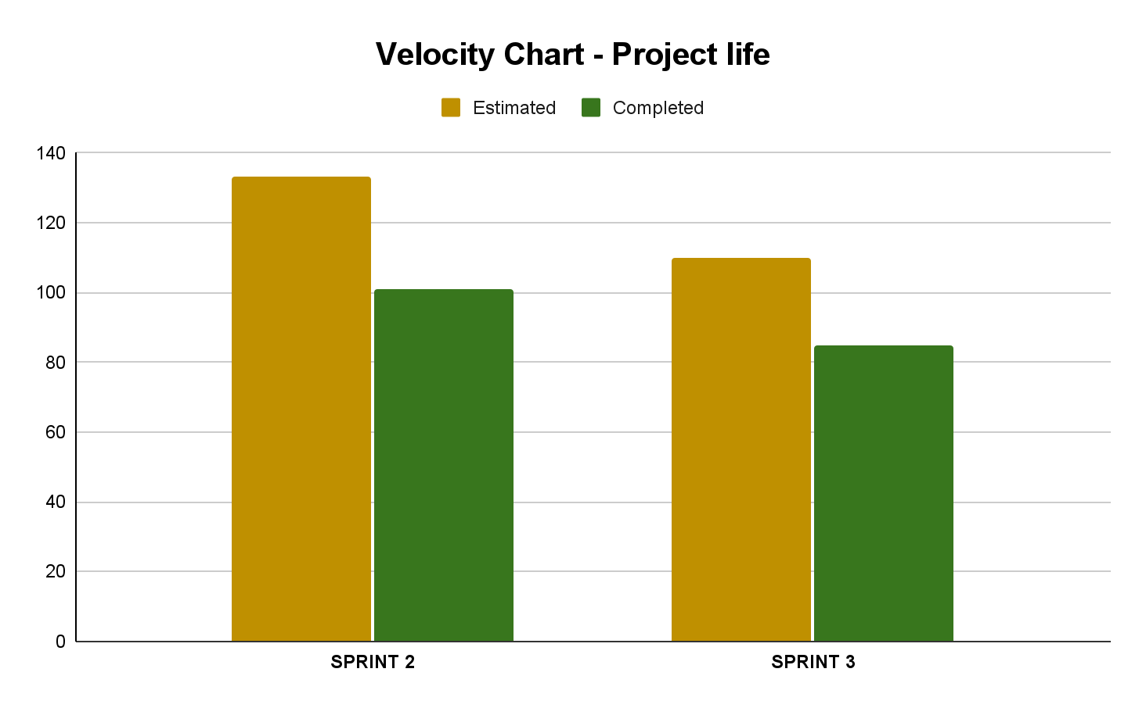

Slide 23
Release Vision
- First version of the app.
- Detect obstacles with LIDAR
- Recognize a human.
- Follow a tracked person.
- First version of the state machine.
- Project plan done.
-Sensor’s failure detection
-Continue obstacle avoidance
-Improve Tracking mode
Sprint 0
Sprint 2
Sprint 4
Sprint 1
Sprint 3
- Improve Tracking mode
- Improve Web Interface
- A safer and a more accurate Tracking mode
- Final state machine.
- Manual control.
- Obstacle detection.
- Emergency stop button on the remote control.
- HMI : visual feedback on the computer (console).

Slide 24
Release Vision
- First version of the app.
- Detect obstacles with LIDAR
- Recognize a human.
- Follow a tracked person.
- First version of the state machine.
- Project plan done.
-Sensor’s failure detection
-Continue obstacle avoidance
-Improve Tracking mode
Sprint 0
Sprint 2
Sprint 4
Sprint 1
Sprint 3
- Improve Tracking mode
- Improve Web Interface
- A safer and a more accurate Tracking mode
- Final state machine.
- Manual control.
- Obstacle detection.
- Emergency stop button on the remote control.
- HMI : visual feedback on the computer (console).

Slide 25
Sprint 4 overview
Story 1 : System checking and safety
Check sensors and inform the user
Detect obstacles in tracking mode
Story 2 : Follow the user properly
Avoid obstacles
Merge tracking features

Slide 26
Annex 1 :
Demo video 1 :
Demo video 2 :
Demo video 3 :

Slide 27
Annex 2 :
Demo video 1 :
Demo video 2 :

Slide 28
Annex 3 :
Demo video1 :

Slide 29
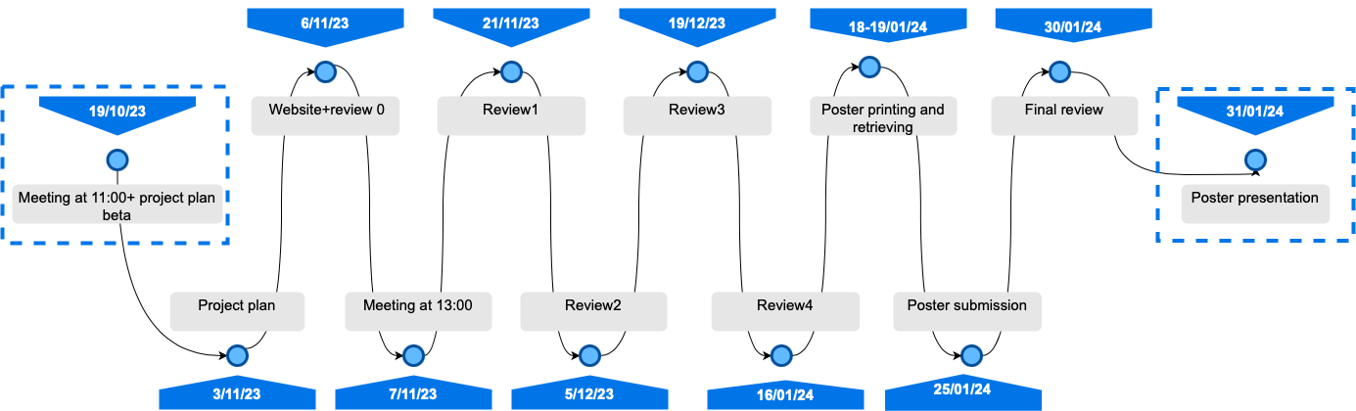
Annex 4 : Deliverables

Slide 30
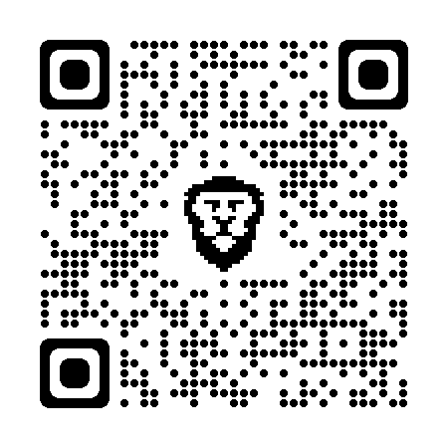
Annex 5 : Website

